Slide 1
Chapter 15: Security

Slide 2
Chapter 15: Security
The Security Problem
Program Threats
System and Network Threats
Cryptography as a Security Tool
User Authentication
Implementing Security Defenses
Firewalling to Protect Systems and Networks
Computer-Security Classifications
An Example: Windows

Slide 3
Objectives
To discuss security threats and attacks
To explain the fundamentals of encryption, authentication, and hashing
To examine the uses of cryptography in computing
To describe the various countermeasures to security attacks

Slide 4
The Security Problem
System secure if resources used and accessed as intended under all circumstances
Unachievable
Intruders (crackers) attempt to breach security
Threat is potential security violation
Attack is attempt to breach security
Attack can be accidental or malicious
Easier to protect against accidental than malicious misuse

Slide 5
Security Violation Categories
Breach of confidentiality
Unauthorized reading of data
Breach of integrity
Unauthorized modification of data
Breach of availability
Unauthorized destruction of data
Theft of service
Unauthorized use of resources
Denial of service (DOS)
Prevention of legitimate use

Slide 6
Security Violation Methods
Masquerading (breach authentication)
Pretending to be an authorized user to escalate privileges
Replay attack
As is or with message modification
Man-in-the-middle attack
Intruder sits in data flow, masquerading as sender to receiver and vice versa
Session hijacking
Intercept an already-established session to bypass authentication

Slide 7
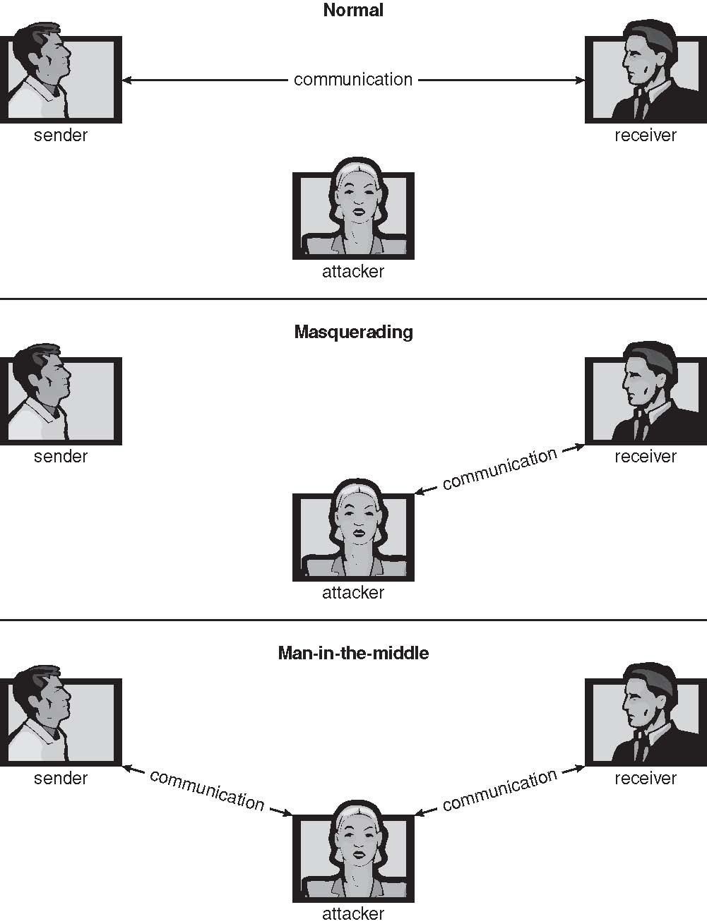
Standard Security Attacks

Slide 8
Security Measure Levels
Impossible to have absolute security, but make cost to perpetrator sufficiently high to deter most intruders
Security must occur at four levels to be effective:
Physical
Data centers, servers, connected terminals
Human
Avoid social engineering, phishing, dumpster diving
Operating System
Protection mechanisms, debugging
Network
Intercepted communications, interruption, DOS
Security is as weak as the weakest link in the chain
But can too much security be a problem?

Slide 9
Program Threats
Many variations, many names
Trojan Horse
Code segment that misuses its environment
Exploits mechanisms for allowing programs written by users to be executed by other users
Spyware, pop-up browser windows, covert channels
Up to 80% of spam delivered by spyware-infected systems
Trap Door
Specific user identifier or password that circumvents normal security procedures
Could be included in a compiler
How to detect them?

Slide 10
Program Threats (Cont.)
Logic Bomb
Program that initiates a security incident under certain circumstances
Stack and Buffer Overflow
Exploits a bug in a program (overflow either the stack or memory buffers)
Failure to check bounds on inputs, arguments
Write past arguments on the stack into the return address on stack
When routine returns from call, returns to hacked address
Pointed to code loaded onto stack that executes malicious code
Unauthorized user or privilege escalation

Slide 11
C Program with Buffer-overflow Condition
#include <stdio.h>
#define BUFFER SIZE 256
int main(int argc, char *argv[])
{
char buffer[BUFFER SIZE];
if (argc < 2)
return -1;
else {
strcpy(buffer,argv[1]);
return 0;
}
}

Slide 12
Program Threats (Cont.)
Viruses
Code fragment embedded in legitimate program
Self-replicating, designed to infect other computers
Very specific to CPU architecture, operating system, applications
Usually borne via email or as a macro
Visual Basic Macro to reformat hard drive
Sub AutoOpen()
Dim oFS
Set oFS = CreateObject(’’Scripting.FileSystemObject’’)
vs = Shell(’’c:command.com /k format c:’’,vbHide)
End Sub

Slide 13
Program Threats (Cont.)
Virus dropper inserts virus onto the system
Many categories of viruses, literally many thousands of viruses
File / parasitic
Boot / memory
Macro
Source code
Polymorphic to avoid having a virus signature
Encrypted
Stealth
Tunneling
Multipartite
Armored

Slide 14
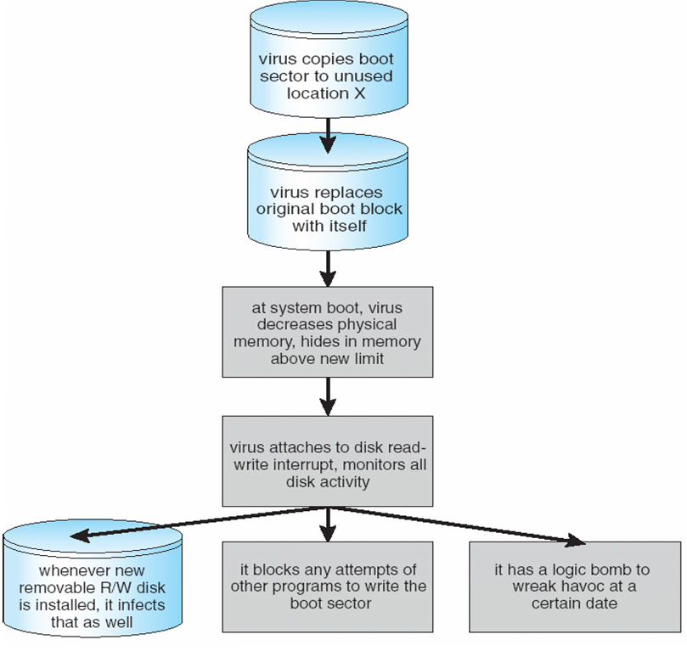
A Boot-sector Computer Virus

Slide 15
The Threat Continues
Attacks still common, still occurring
Attacks moved over time from science experiments to tools of organized crime
Targeting specific companies
Creating botnets to use as tool for spam and DDOS delivery
Keystroke logger to grab passwords, credit card numbers
Why is Windows the target for most attacks?
Most common
Everyone is an administrator
Licensing required?
Monoculture considered harmful

Slide 16
System and Network Threats
Some systems “open” rather than secure by default
Reduce attack surface
But harder to use, more knowledge needed to administer
Network threats harder to detect, prevent
Protection systems weaker
More difficult to have a shared secret on which to base access
No physical limits once system attached to internet
Or on network with system attached to internet
Even determining location of connecting system difficult
IP address is only knowledge

Slide 17
System and Network Threats (Cont.)
Worms – use spawn mechanism; standalone program
Internet worm
Exploited UNIX networking features (remote access) and bugs in finger and sendmail programs
Exploited trust-relationship mechanism used by rsh to access friendly systems without use of password
Grappling hook program uploaded main worm program
99 lines of C code
Hooked system then uploaded main code, tried to attack connected systems
Also tried to break into other users accounts on local system via password guessing
If target system already infected, abort, except for every 7th time

Slide 18
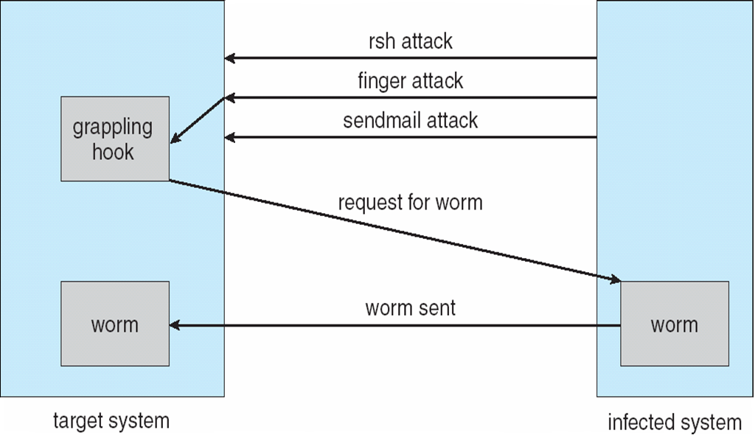
The Morris Internet Worm

Slide 19
System and Network Threats (Cont.)
Port scanning
Automated attempt to connect to a range of ports on one or a range of IP addresses
Detection of answering service protocol
Detection of OS and version running on system
nmap scans all ports in a given IP range for a response
nessus has a database of protocols and bugs (and exploits) to apply against a system
Frequently launched from zombie systems
To decrease trace-ability

Slide 20
System and Network Threats (Cont.)
Denial of Service
Overload the targeted computer preventing it from doing any useful work
Distributed denial-of-service (DDOS) come from multiple sites at once
Consider the start of the IP-connection handshake (SYN)
How many started-connections can the OS handle?
Consider traffic to a web site
How can you tell the difference between being a target and being really popular?
Accidental – CS students writing bad fork() code
Purposeful – extortion, punishment

Slide 21
User Authentication
Crucial to identify user correctly, as protection systems depend on user ID
User identity most often established through passwords, can be considered a special case of either keys or capabilities
Passwords must be kept secret
Frequent change of passwords
History to avoid repeats
Use of “non-guessable” passwords
Log all invalid access attempts (but not the passwords themselves)
Unauthorized transfer
Passwords may also either be encrypted or allowed to be used only once
Does encrypting passwords solve the exposure problem?
Might solve sniffing
Consider shoulder surfing
Consider Trojan horse keystroke logger
How are passwords stored at authenticating site?

Slide 22
Passwords
Encrypt to avoid having to keep secret
But keep secret anyway (i.e. Unix uses superuser-only readably file /etc/shadow)
Use algorithm easy to compute but difficult to invert
Only encrypted password stored, never decrypted
Add “salt” to avoid the same password being encrypted to the same value
One-time passwords
Use a function based on a seed to compute a password, both user and computer
Hardware device / calculator / key fob to generate the password
Changes very frequently
Biometrics
Some physical attribute (fingerprint, hand scan)
Multi-factor authentication
Need two or more factors for authentication
i.e. USB “dongle”, biometric measure, and password

Slide 23
Example: Windows
Security is based on user accounts
Each user has unique security ID
Login to ID creates security access token
Includes security ID for user, for user’s groups, and special privileges
Every process gets copy of token
System checks token to determine if access allowed or denied
Uses a subject model to ensure access security
A subject tracks and manages permissions for each program that a user runs
Each object in Windows has a security attribute defined by a security descriptor
For example, a file has a security descriptor that indicates the access permissions for all users

Slide 24
End of Chapter 15

